Slide 1

JavaScript
05/02/2024

Slide 2
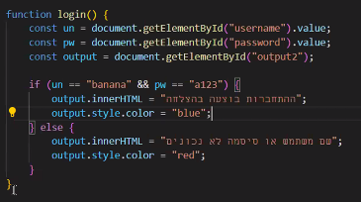
FUNCTION by vars

